Slide 1
Git It Together: “An Introduction to Version Control for Revit Users”
John Pierson
Design Technology Specialist
Parallax Team

Slide 2
git it together
“VERSION CONTROL FOR BEGINNERS”

Slide 3
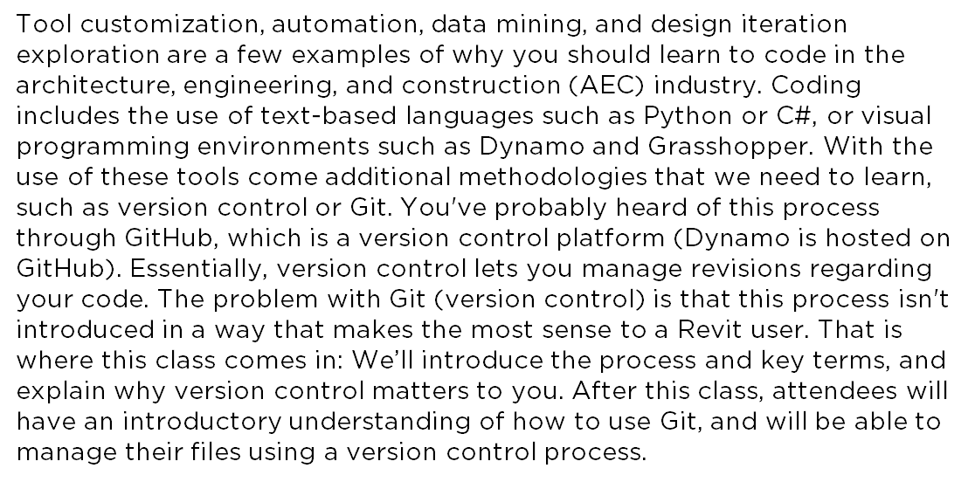
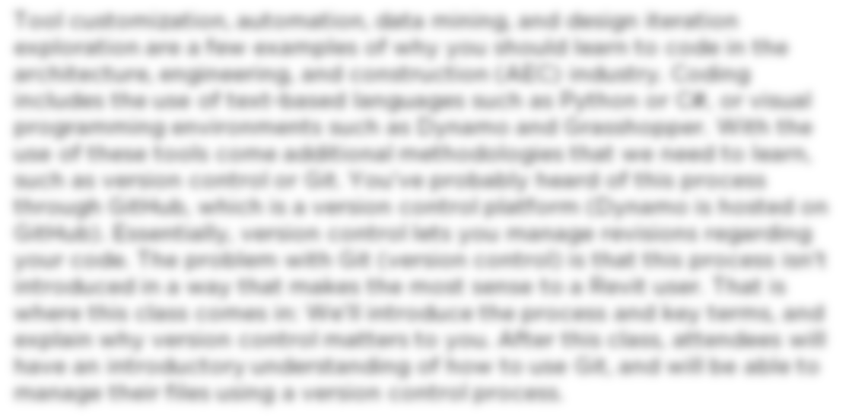
Summary
Essentially, version control lets you manage revisions regarding
your code.
We’ll introduce the process and key terms, and
explain why version control matters to you.

Slide 4
Learning Objectives
Gain an introductory understanding of version control processes.
Understand key Git terms.
Learn how to manage your files using version control.
Learn how to actively contribute to open-source projects.

Slide 5

About the Speaker
John Pierson
Design Technology Specialist at Parallax Team
Reviteer since 2012
Dynamo User since 2014
Dynamo Package Developer since 2015, (Rhythm, Bang!, DuctTape, Monocle).
BILTNA Top Rated Speaker
Revit Certified Professional for Architectural, Structural, MEP

Slide 6

Who are you?

Slide 7
What is Git?
A Version Control Software – Meaning that it manages changes to a project without overwriting any part of that project.
Created in 2005 by Linus Torvalds (linux dude)
Essentially prevents user’s writing over each other’s files, or my personal favorite, you screwing up your code and saving over the working code.

Slide 8
Git is awesome because
All versions are saved via a “snapshot”
You can merge changes and review the differences of the same file that has been modified.
Less losing work = more time for better things.

Slide 9
Why do we need to know this?

Slide 10
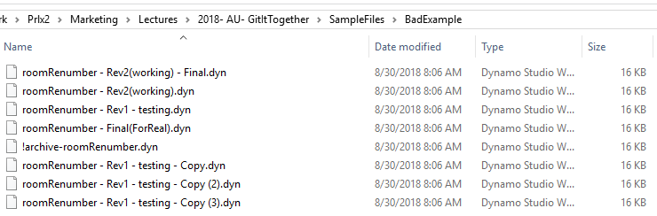
Why do we need to know this?
Sometimes we suck at managing files.

Slide 11
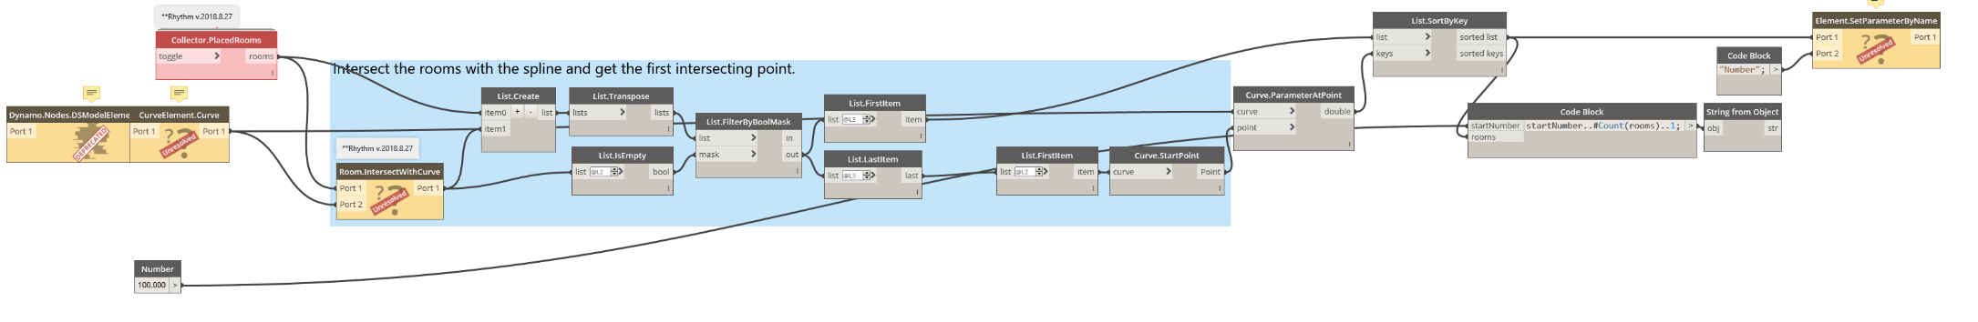
Why do we need to know this?
We’ve all had the “But it worked yesterday” experience.

Slide 12
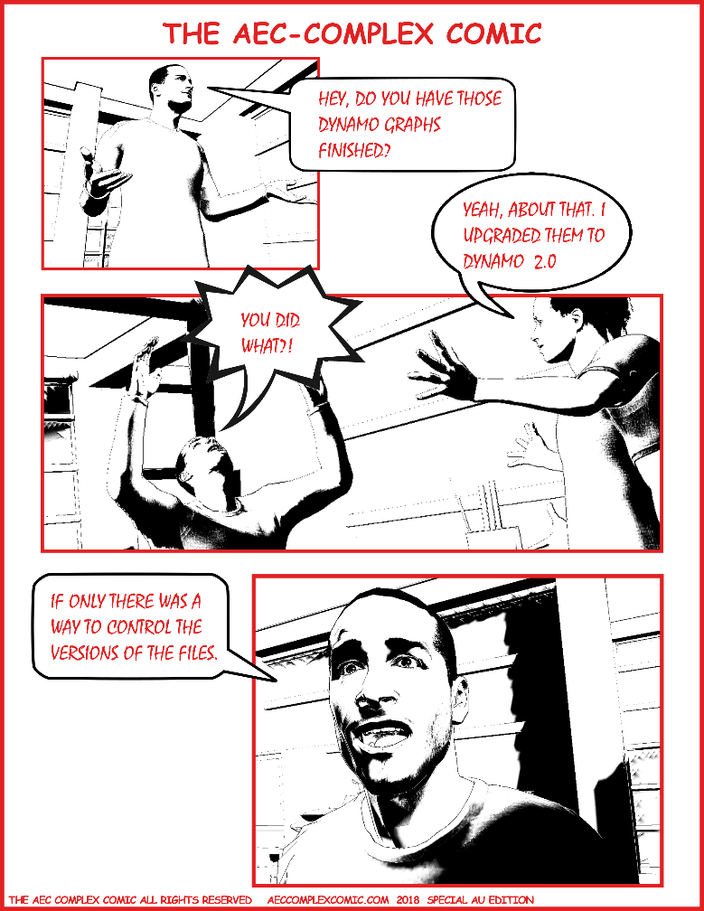
Why do we need to know this?
We have all ran into that one user that “does what they want”.

Slide 13

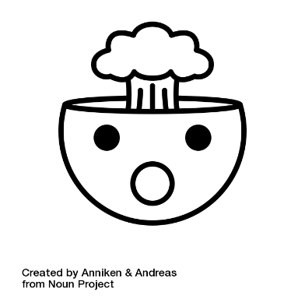

Why don’t we all know how to use this?
command line (primarily)
you don’t know what you don’t know
not the most intuitive thing with new terms and processes

Slide 14
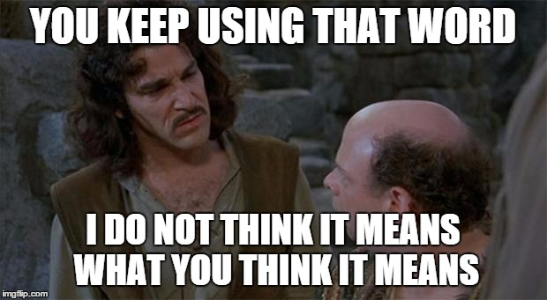
Key Terminology

Slide 15
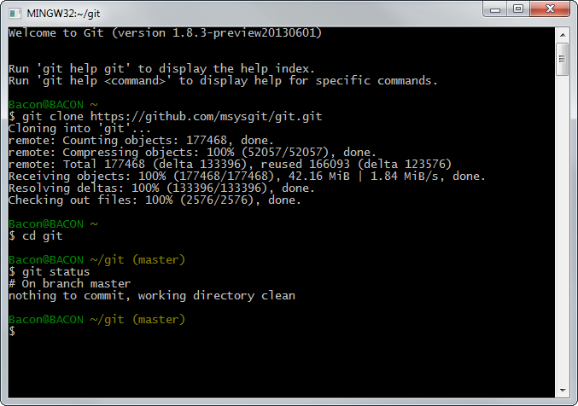
Key Terminology Command Line
Interface for text-based input for Git. (not how we are going to be doing this today)
https://gitforwindows.org/

Slide 16
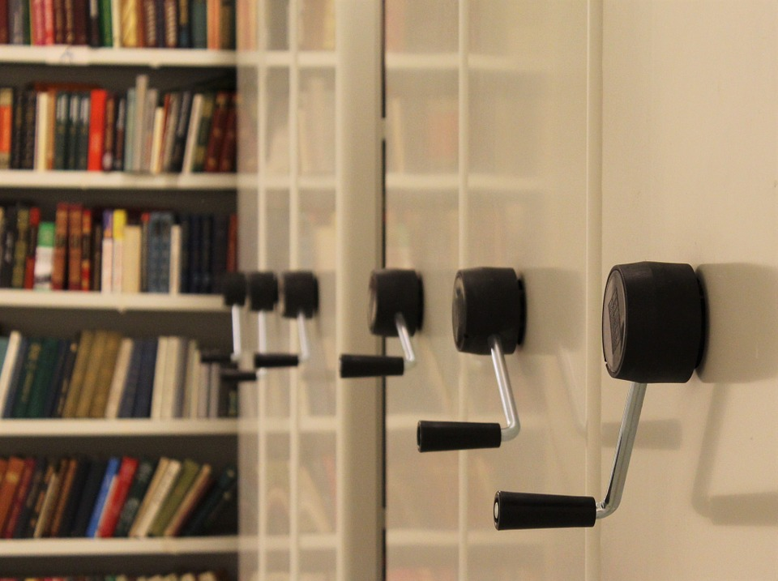
Key Terminology Repository/Repo
Storage space where your projects live. (similar to a Revit central file)

Slide 17
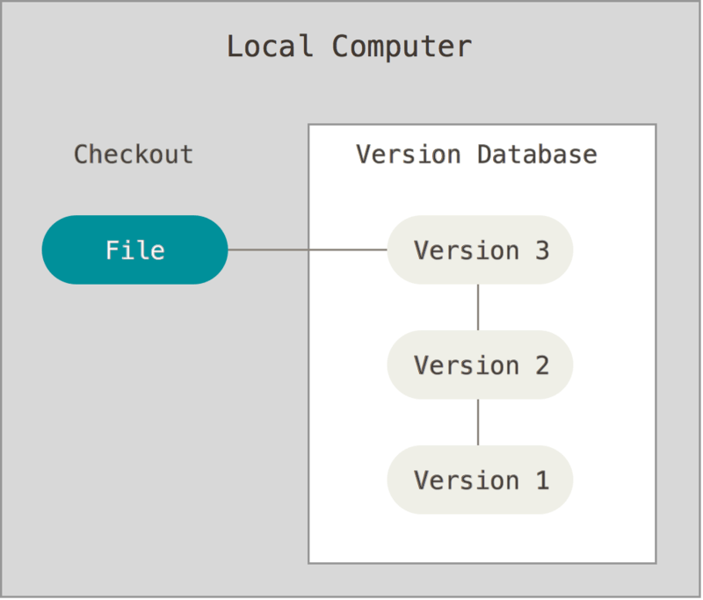
Key Terminology Version Control
Instead of manually saving multiple versions, Git saves “snapshots” of every point in time for the life of the project. (similar to Revit’s backup folder, but better.)

Slide 18

Key Terminology Commit
This is the beautiful part. A commit is you pushing your changes to Git. Each time you commit to the repo, Git takes a snapshot to give you a checkpoint to go back to if needed. (similar to a sync with central, but also way better)
Sending your changes off to the repo!

Slide 19
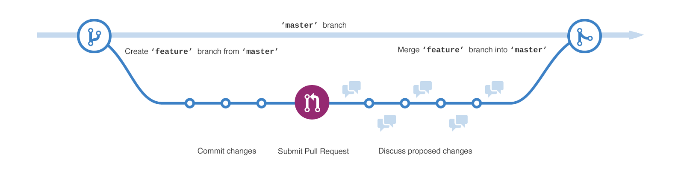
Key Terminology Branch
This allows people to work on their own version of the project before pushing the changes back to the main project. (similar to a Revit local file)

Slide 20
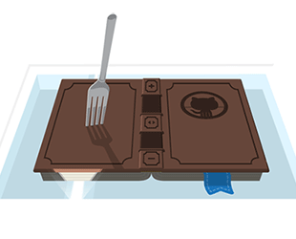
Key Terminology Fork
Your very own copy of a project separate from the source project with the option to push your changes to the source if you want to.

Slide 21
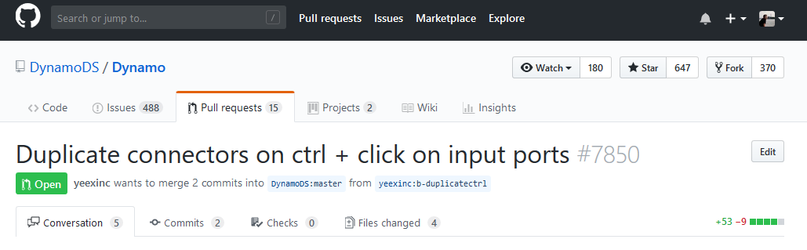
Key Terminology Pull Request
A way of submitting contributions to an open project. This is done by making changes on your fork and generating the pull request (PR).

Slide 22
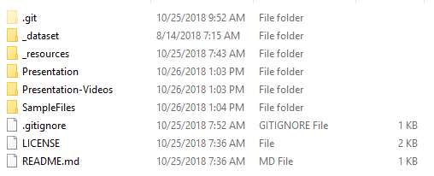
Key Terminology .gitignore
When you are managing a project with version control, there are definitely going to be files you don’t want to “sync” to the repo. Rather than removing these files from the local repo we can tell github to ignore them by extension!

Slide 23
This AU Class was… built using Github

Slide 24
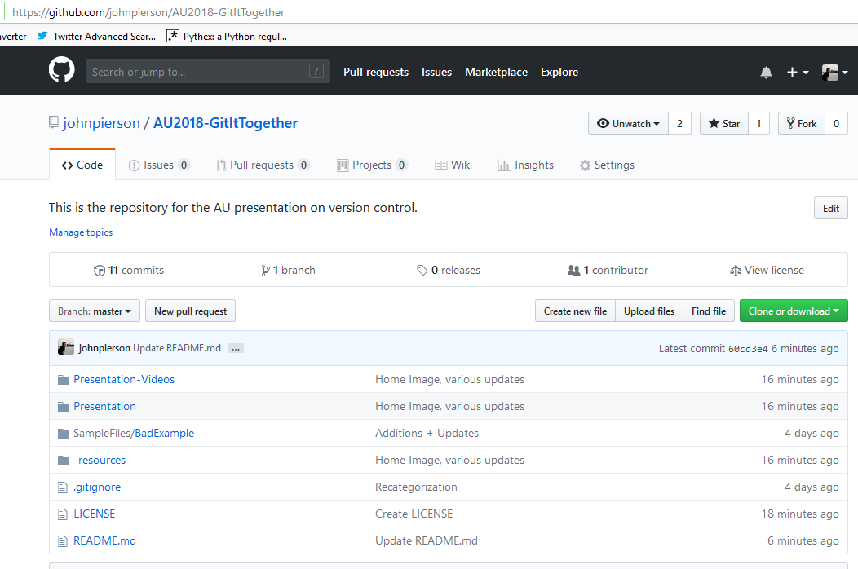
This AU Class was… built using Github
The landing page with all the data

Slide 25
Resources
Markdown
https://guides.github.com/features/mastering-markdown/
https://github.com/adam-p/markdown-here/wiki/Markdown-Cheatsheet
Misc
This exact presentation’s repo. https://github.com/johnpierson/AU2018-GitItTogether
https://guides.github.com/activities/hello-world/
License
Choose a license https://choosealicense.com/
Creative Commons https://creativecommons.org/

Slide 26
Now, Let’s Build Some Workflows. (and use version control)
Start a Github Project
Establish ReadMe and .gitignore
Choose a license
Build cool stuff and manage it.
Collaborate: AKA Have other users mess with it.

Slide 27
thank you.
NOW, GO DO AWESOME THINGS
@prlxteam | @twiceroadsfool | @60secondrevit

Slide 28

Creating a Repo

Slide 29
Cloaning a Repo Locally

Slide 30
Uploading Files

Slide 31
Autodesk and the Autodesk logo are registered trademarks or trademarks of Autodesk, Inc., and/or its subsidiaries and/or affiliates in the USA and/or other countries. All other brand names, product names, or trademarks belong to their respective holders. Autodesk reserves the right to alter product and services offerings, and specifications and pricing at any time without notice, and is not responsible for typographical or graphical errors that may appear in this document.
© 2018 Autodesk. All rights reserved.

